Slide 1
A Vision Of Restoration
Sister Jean Tate – Nursery/Preschool
Lesson 10 - May 3, 2020 – Zephaniah

Slide 2
Justice Wins The Day - Zephaniah
Zephaniah was a prophet, a special person who speaks for God
God told Zephaniah what to say to Israel, God’s people
Tell Israel they don’t trust God, they don’t obey God, and they aren’t making good choices

Slide 3
God Loves You Anyway
When you don’t make good choices, you have to be disciplined, so you can learn from your wrong decisions
But remember, God always forgives, God always loves you. You will always be God’s people. You will trust in Him again, you will love Him again. He will always help you

Slide 4
Knowing The Right Choices
Justice
Kindness
Forgiveness
(Are All The Right Choices)

Slide 5
How Do We Show God’s Right Choices
Treating EVERYONE like we want to be treated – remember we all have feelings
Show kindness to others even if they are not showing it to us, practice being kind to others, maybe they are just having a bad day – we can be kind
Always forgive others, remember God forgave us, because He loves us

Slide 6
Dear Parents/Grandparents /Teachers
Your child learned about God’s justice, kindness, and forgiveness through the prophet Zephaniah. This week, encourage your child to show kindness and forgiveness to others, as God first showed it to us

Slide 7
This Little Light Of Mine
The just Lord is in the midst thereof; He will not do iniquity; every morning doth He bring judgement to light – Zephaniah 3:5
Let your light so shine before men, that they may see your good works and glory your Father which is in heaven – Matthew 5:16

Slide 8
Justice Wins The Day
Primary Lesson: Faith Brown

Slide 9
IN THE END, YOU WIN! SENIOR HIGH DR. JANE A. CROSSLEY SUNDAY, MAY 3, 2020

Slide 10
ACTIVITY #1
ON YOUR CHAT, PLEASE ANSWER THE FOLLOWING QUESTIONS.
LIST SOME WORDS THAT DESCRIBE WHO GOD IS
TO YOU.

Slide 11
OBJECTIVES
TLW DISCUSS GOD’S RESTORATION OF PEACE, RIGHTEOUSNESS, AND
JUSTICE
TLW DISCUSS THE SHORT PASSAGE ON, “IN THE END, YOU WIN!”
TLW DISCUSS WHEN GOD IS OUR PROTECTOR AND KING, WE HAVE NOTHING TO FEAR
TLW DISCUSS A SUMMARY OF THE TODAY’S SCRIPTURES
TLW DEFINE WORDS AND PHRASES IN THIS LESSON

Slide 12
IN THE END, YOU WIN!
BIBLE TRUTH: A VISION OF RESTORATION
BIBLE BASIS: ZEPHANIAH 3:14-20
MEMORY VERSE: BEHOLD, AT THAT TIME I WILL UNDO ALL THAT AFFLICT THEE: AND I WILL SAVE HER THAT HALTETH, AND GATHER HER THAT WAS DRIVEN OUT; AND I WILL GET THEM PRAISE AND FAME IN EVERY LAND WHERE THEY HAVE BEEN PUT TO SHAME.

Slide 13
TERMS AND DEFINTIONS FOR THIS LESSONS
“SING , DAUGHTER OF ZION! SHOUT, ISRAEL! BE GLAD AND REJOICE WITH ALL YOUR HEART, DAUGHTER OF JERSUALEM”(v.14). Zion, Israel, and Jerusalem are essentially synonymous as used in this verse
“DON’T LET YOUR HANDS BE WEAK” ( v. 16c) – The posture of the hand can symbolize weakness-discouragement. With the Lord as their king, the people of Judah will have no reason to let their hands grow weak-to act submissively
“YAHWEH, YOUR GOD, IS IN THE MIDST OF YOU, A MIGHTY ONE WHO WILL SAVE” (v. 17. In the day which the prophet is predicting, Yahweh will be present with his people-present as a warrior who will bring Judah victory over her enemies

Slide 14
TERMS AND DEFINTIONS
RESTORATION - The biblical meaning of the word "restoration" is to receive back more than has been lost to the point where the final state is greater than the original condition. The main point is that someone or something is improved beyond measure.
ZEPHANIAH . ZEH – FUH – NYE –UH

Slide 15
SUMMARY OF THE LESSON
TODAY’S LESSON DEALS WITH THE RELATIONSHIP THAT GOD HAS WITH ISRAEL
HE PROMISED TO PROVIDE FOR HIS CHOSEN PEOPLE
THE CITY OF JERUSALEM IS PRESENTED AS IF IT WERE A VULNERABLE DAUGHTER WHO NEEDS THE PROTECTION OF A KING
IN OTHER WORDS, JERUSALEM IS TOTALLY DEPENDENT UPON THE LORD FOR SUSTENANCE , STRENGTH , AND PROTECTION.

Slide 16
SUMMARY OF TODAY’S LESSON (#2)
GOD IS PICTURED AS THE KING AND WARRIOR WHO PROTECTS AND RESCUES HIS DAUGHTER JERUSALEM FROM HER ENEMIES
HERE WE SEE THE CLOSE RELATIONSHIP THAT GOD SEEKS TO SHARE WITH HIS PEOPLE AT ALL TIMES.
JERUSALEM WILL SING AND REJOICE REMOVING ANY DISASTER OR THREAT THAT SEEKS TO BEFALL THE CITY OF JERUSALEM. GOD IS EVER-VIGILANT WHEN IT COMES TO PROTECTING AND RESTORING HIS PEOPLE.
GOD IS EVER –VIGILANT WHEN IT COMES TO PROTECTING AND RESTORING HIS PEOPLE

Slide 17
SUMMARY OF TODAY’S LESSON(#3)
PASSAGES SUCH AS THE ONE THAT SPEAK OF THE LORD OR “THAT DAY” CAN HAVE BOTH AND IMMEDIATE APPLICATION IN THE TEXT AND REFER TO THE SECOND COMING OF JESUS
WHEN GOD IS OUR PROTECTOR AND KING, WE HAVE NOTHING TO FEAR

Slide 18
IN THE END , YOU WIN
CHARACTERS: LUPITA AND GOD
SITUATION: LUPITA HAD BEEN WRONGFULLY ACCUSED OF STEALING SOME MONEY OUT OF A FELLOW STUDENT’S LOCKER
LUPITA HAD ALWAYS WORKED HARD, CARED FOR OTHERS, AND ALWAYS STOOD UP FOR PEOPLE WHEN THEY NEEDED HELP
ONE OF THE STUDENTS WHO PICKED ON HER ACCUSED HER OF STEALING FROM ANOTHER STUDENT.
LUPITA WAS SENT TO THE PRINCIPAL’S OFFICE.

Slide 19
IN THE END, YOU WIN!( #2)
AFTER THE PRINCIPAL INVESTIGATED THIS SITUATION WITH LUPITA AND HER CLASSMATES, HE ASKED LUPITA TO WAIT OUTSIDE HIS OFFICE
LUPITA STARTED PRAYING THAT GOD WILL BRING HER INNOCENCE TO LIGHT.
THE PRINCIPAL TOLD HER THAT THE STUDENT WHOSE MONEY WENT MISSING WAS FOUND IN ANOTHER STUDENT’S LOCKER AND THAT HE WOULD SPEAK TO HER ACCUSSERS.

Slide 20
THE CONCLUSION OF THE LESSON FOR TEENS
WHEN GOD IS YOUR PROTECTOR AND KING, THERE IS NO NEED TO FEEL AFRAID OR WEAK
SCHOOL
CORONAVIRUS

Slide 21
IN THE END, YOU WIN!
QUESTION
SINCE GOD IS YOUR PROTECTOR AND KING
WHAT ARE YOU EXPECTING GOD TO DO FOR YOU?
PLEASE USE YOUR CHAT BOX AS WELL AS SPEAKING YOUR ANSWERS

Slide 22
SENIOR HIGH LESSON ABOUNDING LIFE COGIC 14626 MOZART, POSEN, IL 60469
THANK YOU!
REMEMBER
IN THE END, YOU WIN!

Slide 23
SONGS of VICTORY
Sing, O daughter of Zion; shout, O Israel; be glad and rejoice with all the heart, O daughter of Jerusalem.
Zephaniah 3:14
Minister of Music: Zorriante Brown

Slide 24
List of Songs of Victory & Triumph (some examples)
“Victory, Victory Shall be Mine” (traditional)
“Don’t Wait til the Battle is Over”-Walter Hawkins
“I made it”-Deandre Patterson
“I made it Over”
“To God be the Glory”-Andrae Crouch
“I’ve Got the Victory”-Ricky Dillard
“Victory Comes”- Beverly Crawford
“A Move of God is on the Way”-Norman Hutchins
“Get Back Satan!”-Creflo Dollar
“My Name is Victory”-Jonathan Nelson
…………………………………………………………………

Slide 25
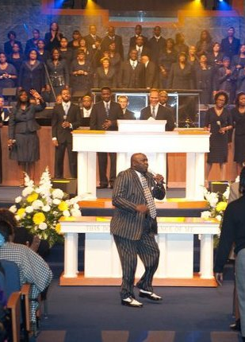
AL Victory Songs/Chants written by: Pastor James R. Adams
“Glory!”
“The Lord Shall Lighten My Darkness”
“I’m going to Come Through Singing, Singing”
“Then My Lord will carry me through”
“We Sing and Praise the Lord”
I’ve Got the Victory”

Slide 26
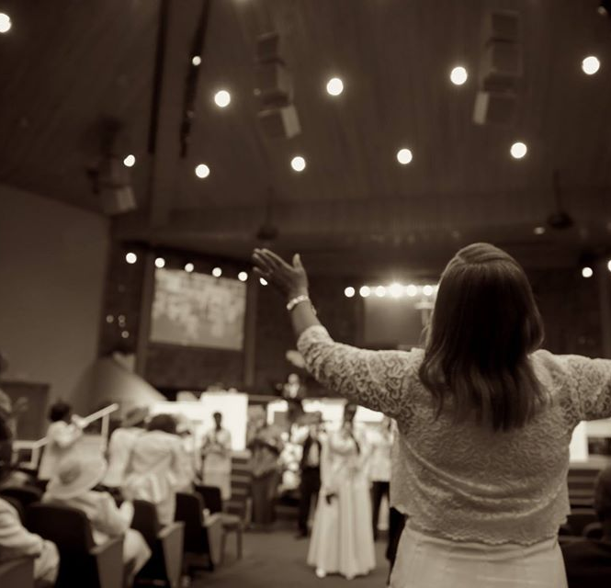
What is your song of Victory?????

Slide 27
A Vision Of Restoration
Bible Basis: Zeph. 3:14-20
Bible Truth: The Lord shares His plans to restore Israel bask to Himself.
Memory Verse: Zeph 3:19
19 Behold, at that time I will undo all that afflict thee: and I will save her that halteth, and gather her that was driven out; and I will get them praise and fame in every land where they have been put to shame.
KJV

Slide 28
A Vision Of Restoration
Lesson Aim: By the end of this lesson, we will:
Discern the need for the just restoration of God’s people
PURSUE trusting God for bictory, hope and renewal
Celebrate the return of joy and God’s glory in salvation

Slide 29
I. ZION SINGS A SONG OF JOY Zephaniah 3:14-15
Missionary Daintry McFadden

Slide 30
SING AND SHOUT!!!!!
There is HOPE God wrath is not the final word
There will be peace and nothing to fear
Zephaniah 3:14
¹⁴ Sing, O daughter of Zion; shout, O Israel; be glad and rejoice with all the heart, O daughter of Jerusalem.
Zephaniah 3:14-15 New International Version (NIV)
¹⁴ Sing, Daughter Zion; shout aloud, Israel! Be glad and rejoice with all your heart, Daughter Jerusalem!

Slide 31
“JOYOUS SHOUT”
^{SING}
Psalms 149:1 Praise ye the Lord. Sing unto the Lord a new song, and his praise in the congregation of saints.
^{SHOUT ALOUD}
Psalms 32:11 Be glad in the Lord, and rejoice, ye righteous: and shout for joy, all ye that are upright in heart.
^{BE GLAD}
^{REJOICE}
Philippians 4:4 Rejoice in the Lord always: and again I say, Rejoice.
Not Perfunctory- Carried out with a minimum of effort or reflection

Slide 32
THE COMMAND: PRAISE
2 Chronicles 5:13 King James Version (KJV)
¹³ It came even to pass, as the trumpeters and singers were as one, to make one sound to be heard in praising and thanking the Lord; and when they lifted up their voice with the trumpets and cymbals and instruments of musick, and praised the Lord, saying, For he is good; for his mercy endureth for ever: that then the house was filled with a cloud, even the house of the Lord;
2 Chronicles 20:21 King James Version (KJV)
²¹ And when he had consulted with the people, he appointed singers unto the Lord, and that should praise the beauty of holiness, as they went out before the army, and to say, Praise the Lord; for his mercy endureth for ever.
I

Slide 33
3 Reasons for Rejoicing
Zephaniah 3:15 King James Version (KJV)
¹⁵ The Lord hath taken away thy judgments, he hath cast out thine enemy: the king of Israel, even the Lord, is in the midst of thee: thou shalt not see evil any more.
1) The punishment and the enemy have been turned away
2) The enemy is cast out
3) The Lord is King in the midst of her

Slide 34
Question 2
What song would you sing in response to how God has moved in your life?

Slide 35
A Vision of Restoration
II. God Sings a Song of Joy
(Zephaniah 3:16-18)
Elder Charles Ammons

Slide 36
A Vision of Restoration
Zeph. 3:16-18
16 In that day it shall be said to Jerusalem, Fear thou not: and to Zion, Let not thine hands be slack.
17 The LORD thy God in the midst of thee is mighty; he will save, he will rejoice over thee with joy; he will rest in his love, he will joy over thee with singing.
18 I will gather them that are sorrowful for the solemn assembly, who are of thee, to whom the reproach of it was a burden.
KJV

Slide 37
A Vision of Restoration
Question 3
What does the phrase “on that day” refer to in this passage?
Question 4
In our world today, we see a lot of pain, but we also see many causes to celebrate. What would cause the Lord to sing today?

Slide 38
A Vision of Restoration
III. FULL RESTORATION
(Zephaniah 3:19-20)
Supt. Elder Bernard Verner

Slide 39
A Vision of Restoration
Zeph 3:19-20
19 Behold, at that time I will undo all that afflict thee: and I will save her that halteth, and gather her that was driven out; and I will get them praise and fame in every land where they have been put to shame.
20 At that time will I bring you again, even in the time that I gather you: for I will make you a name and a praise among all people of the earth, when I turn back your captivity before your eyes, saith the LORD.
KJV

Slide 40
A Vision of Restoration
The previous verses dealt with the remnant’s spiritual, emotional, and mental wellness.
Verses 19 and 20 deal with the remnant’s social location.
They have been oppressed, cast away, and robbed of their fortune.
The benefits of their identity have been stripped.
They were mocked and shamed because of their identity.

Slide 41
A Vision of Restoration
Now God promises to remove their oppressors.
God promises to bring the remnant together.
God promises to give them a good name.
God promises to restore their fortunes.

Slide 42
A Vision of Restoration
There is no lack in the remnant because they have full relational love for God as much as he loves them.
The remnant commit to being faithful children.
They have an identity and a community of God’s gathered people.
They are full socially because those who were not able to help themselves are in God’s care and have full access to their fortunes.

Slide 43
A Vision of Restoration
Zeph 3:19
19 Behold, at that time I will undo all that afflict thee: and I will save her that halteth, and gather her that was driven out; and I will get them praise and fame in every land where they have been put to shame.
KJV

Slide 44
A Vision of Restoration
In Verse 19 –
God is going to deal with Jerusalem’s oppressors.
He will deal with those who afflicted his people
They would not escape the fire of His wrath
The use of the word all speaks to all past enemies that afflicted Zion such as Assyria and Babylon as well as the neighbors who took advantage of the Babylonian attack.

Slide 45
A Vision of Restoration
God promised that he would gather them together and they would be free from all oppression.
God promised the make the “halteth” – the lame and the “driven out” – the banished or exiled (A people who were helpless, hapless, and homeless) a strong nation.
He will make his people a “praise” instead of a “shame”.
(their change in status would change their reputation as well)

Slide 46
A Vision of Restoration
Zeph 3:20
20 At that time will I bring you again, even in the time that I gather you: for I will make you a name and a praise among all people of the earth, when I turn back your captivity before your eyes, saith the LORD.

Slide 47
A Vision of Restoration
Verse 20 is a repeat of the promise made in verse 19 with a little variation in wording. This emphasizes God’s promise to execute what he has decreed.
God promises to restore their fortunes or make the prosperous again.
God promises this restoration will take place “before their eyes” meaning that it will occur in this generation.
God uses the personal pronoun “I” meaning that he is taking personal responsibility for Israel’s redemption and restoration.

Slide 48
A Vision of Restoration
God is promising a total reversal of the world order. Just as the book began with the devastating overthrow of Jerusalem, it ends with the people being returned to the land.
The ultimate fulfillment of this promise will occur at the end of the world when God himself will rule in righteousness in the earth, but this prophecy was partially fulfilled when the Jews returned to rebuild Jerusalem at the end or the 70 year exile.
So we look forward to the Messianic age where Jesus will rejoice over, rest in love, and joy over with singing his redeemed.

Slide 49
A Vision of Restoration
Question 5
What purpose does this passage serve in the book of Zephaniah?
Question 6
What makes our restoration complete?

