Slide 1
Jesus Is Alive
Sister Jean Tate April 12, 2020

Slide 2
Teaching Preschoolers About Easter
Bunnies and egg hunts are fun, but such activities need to remain separate from Bible teaching and the story of Christ’s death and resurrection.
Teach your preschoolers to focus on biblical truths about Easter.

Slide 3
Knowing The Understanding Levels Of Each Child
Teach concepts and stories that our children can understand
Each child develops differently according to God’s plan
The foundation to the Easter story is Jesus’ love for all people

Slide 4
Jesus Is Alive
Reading the narrative from Scripture: Mark 16: 1-8; John 20: 1-18

Slide 5
Telling The Easter Story
Jesus saved the world. He is our savior
The home offers the best place for bible teaching. Truths can be explained and reinforced correctly
Parents know their child’s learning abilities and parents, teachers work together.

Slide 6
This Is Not The End Of The Story
Tell
Tell the story as not to create fear.
Know
Young children need to know that Jesus’ death is not the end of the story. He arose from death and He is alive.
Talk
Talk to the children in warm, reassuring tones.
Avoid
Avoid using secular traditions. This is a holy story!

Slide 7
Preschoolers may have questions about words they hear
Angel - A Messenger from God
Cross - A wooden structure where Jesus died
Disciple – One who follows and learns from Jesus
Tomb – A place to bury people who are dead

Slide 8
HE IS NOT HERE! SENIOR HIGH DR. JANE A. CROSSLEY APRIL 12, 2020

Slide 9
HE IS NOT HERE!
BIBLE TRUTH: RESURRECTION HOPE
BIBLE BASIS: CORINTHIANS 15: 1-8, 12-14, 19-23, 42-45
MEMORY VERSE: “ IF IN THIS LIFE ONLY WE HAVE HOPE IN CHRIST, WE ARE OF ALL MEN MOST MISERABLE. BUT NOW IS CHRIST RISEN FROM THE DEAD, AND BECOME THE FIRSTFRUITS OF THEM THAT SLEPT” ( 1 CORINTHIANS 15:19-20, KJV).

Slide 10
OBJECTIVES OF THE TODAY’S LESSON
TLW DISCUSS AND REFLECT ON JESUS’ EMPTY TOMB
TLW DISCUSS HOW TO DEVELOP A DEEPER UNDERSTANDING OF THE RESURRECTION; AND EXPRESS TO OTHERS THEIR UNDERSTANDING OF THE RESURRECTION

Slide 11
THE REFLECTION OF TODAY’S LESSON
JESUS’ EMPTY TOMB
BELIEVERS ARE REMINDED OF THE FOUNDATION OF THE GOSPEL, WHICH IS THE GOOD NEWS
THE GOOD NEWS IS THAT CHRIST DIED FOR OUR SINS
THE PERISHABLE BODY PUT ON THE IMPERISHABLE FOR US
WITHOUT THE THE RESURRECTION, THE GOSPEL IS INCOMPLETE AND NONEFECTIVE

Slide 12
HE IS NOT HERE!
EASTER’S SUNDAY
THE CHURCH ON THE HILL

Slide 13
HE IS NOT HERE PRESENTATION!
GWENDOLYN GASTON GRAY

Slide 14
REVIEW OF TODAY’S PRESENTATION
WHAT IS SIGNIFICANT ABOUT THE EMPTY TOMB?
WHAT DO WE MEAN ABOUT THE TERM, “RESURRECTION?”
WHAT WOULD THIS WORLD BE LIKE IF THE RESURRECTION OF JESUS HADN’T OCCURRED?

Slide 15
HE IS NOT HERE EASTER’S STORY MY LIFE IS WORTH LIVING BECAUSE JESUS LIVES

Slide 16
RESURRECTION HOPE
I. RESURRECTION CLARIFIED AND WITNESSED
(1Corinthians 15:1-8)
SUPT. ELDER BERNARD VERNER

Slide 17
RESURRECTION HOPE
We need to understand that the Bible is a collection of books. What we find in 1Corinthians is a letter that the apostle wrote to the church that he established in Corinth.
Paul’s objective in the letter is to straighten out a church that had fallen into sin.
Some of its members were guilty of sexual immorality, others got drunk; still others were using the grace of God to excuse worldly living. It was also a divided church, with at least four different groups competing for leadership

Slide 18
RESURRECTION HOPE
Paul dealt with many of the issues of the church in 1 Corinthians chapters 1 through 14. Now in 1 Corinthians 15th chapter, he starts off dealing with the significance of Christ’s resurrection.

Slide 19
RESURRECTION HOPE
1 Cor 15:1-2
1 Moreover, brethren, I declare unto you the gospel which I preached unto you, which also ye have received, and wherein ye stand;
2 By which also ye are saved, if ye keep in memory what I preached unto you, unless ye have believed in vain.
KJV

Slide 20
RESURRECTION HOPE
Some in the Corinthian church did not believe that Christ was resurrected because they exalted the spiritual so much that they devalued the physical.
Paul begins his argument with the good news that they owe the existence of the community of faith that was obtained by believing the gospel which he preached.

Slide 21
RESURRECTION HOPE
1 Cor 15:3-5
3 For I delivered unto you first of all that which I also received, how that Christ died for our sins according to the scriptures;
4 And that he was buried, and that he rose again the third day according to the scriptures:
5 And that he was seen of Cephas, then of the twelve: KJV

Slide 22
RESURRECTION HOPE
The foundation of the gospel has three major components:
1. Jesus Christ died for our sins
2. Jesus Christ was buried
3. Jesus Christ rose on the third day
Paul emphasized these three points are supported by scripture/prophesy, tradition, and apostolic authority.

Slide 23
RESURRECTION HOPE
1 Cor 15:6-8
6 After that, he was seen of above five hundred brethren at once; of whom the greater part remain unto this present, but some are fallen asleep.
7 After that, he was seen of James; then of all the apostles.
8 And last of all he was seen of me also, as of one born out of due time.
KJV

Slide 24
RESURRECTION HOPE
Paul offers further proof that Jesus was resurrected:
1. He as seen by James and the twelve
2. He was seen by over 500 followers
3. He was seen by Paul.

Slide 25
RESURRECTION HOPE
The last piece of evidence that is added to the foundation that Paul laid is the fact that there is an empty tomb. “ He is not here: for he is risen, as he said.” Matt 28:6A Declares the angel at the tomb.

Slide 26
RESURRECTION HOPE
Question 1: Paul writes to the church at Corinth about the resurrection of Jesus Christ. Why is it necessary for Paul to affirm that Christ is risen?
Question 2: Paul focuses his argument in three things. What are they?

Slide 27
II. Resurrection Guaranteed II Corinthians 15:12-14
Missionary Daintry McFadden

Slide 28
Guaranteed defined as……..
Provide a formal assurance that certain conditions shall be fulfilled
Promise with certainty
1 Corinthians 15:12 King James Version (KJV)
¹² Now if Christ be preached that he rose from the dead, how say some among you that there is no resurrection of the dead?
Paul reassures his audience that Jesus had indeed risen from the dead

Slide 29
NO RESSURECTION???????
1 Corinthians 15:13
¹³ But if there be no resurrection of the dead, then is Christ not risen:
Adam brought death for all
Jesus brings eternal life for those who believes in him
John 3:16
¹⁶ For God so loved the world, that he gave his only begotten Son, that whosoever believeth in him should not perish, but have everlasting life.

Slide 30
Resurrection the CORE of the Gospel
¹⁴ And if Christ be not risen, then is our preaching vain, and your faith is also vain.
Paul argues that it is essential that Jesus Christ rose from the dead for our faith in him to be valid.

Slide 31
Jesus Christ was resurrected first so that all belong to Him will be resurrected
Romans 6:4-5 King James Version (KJV)
⁴ Therefore we are buried with him by baptism into death: that like as Christ was raised up from the dead by the glory of the Father, even so we also should walk in newness of life.
⁵ For if we have been planted together in the likeness of his death, we shall be also in the likeness of his resurrection:
Romans 6:4-5 Living Bible (TLB)
⁴ Your old sin-loving nature was buried with him by baptism when he died; and when God the Father, with glorious power, brought him back to life again, you were given his wonderful new life to enjoy.
⁵ For you have become a part of him, and so you died with him, so to speak, when he died;^{[a]} and now you share his new life and shall rise as he did.

Slide 32
Ask Me How Do I Know He Lives
He Lives within MY HEART

Slide 33
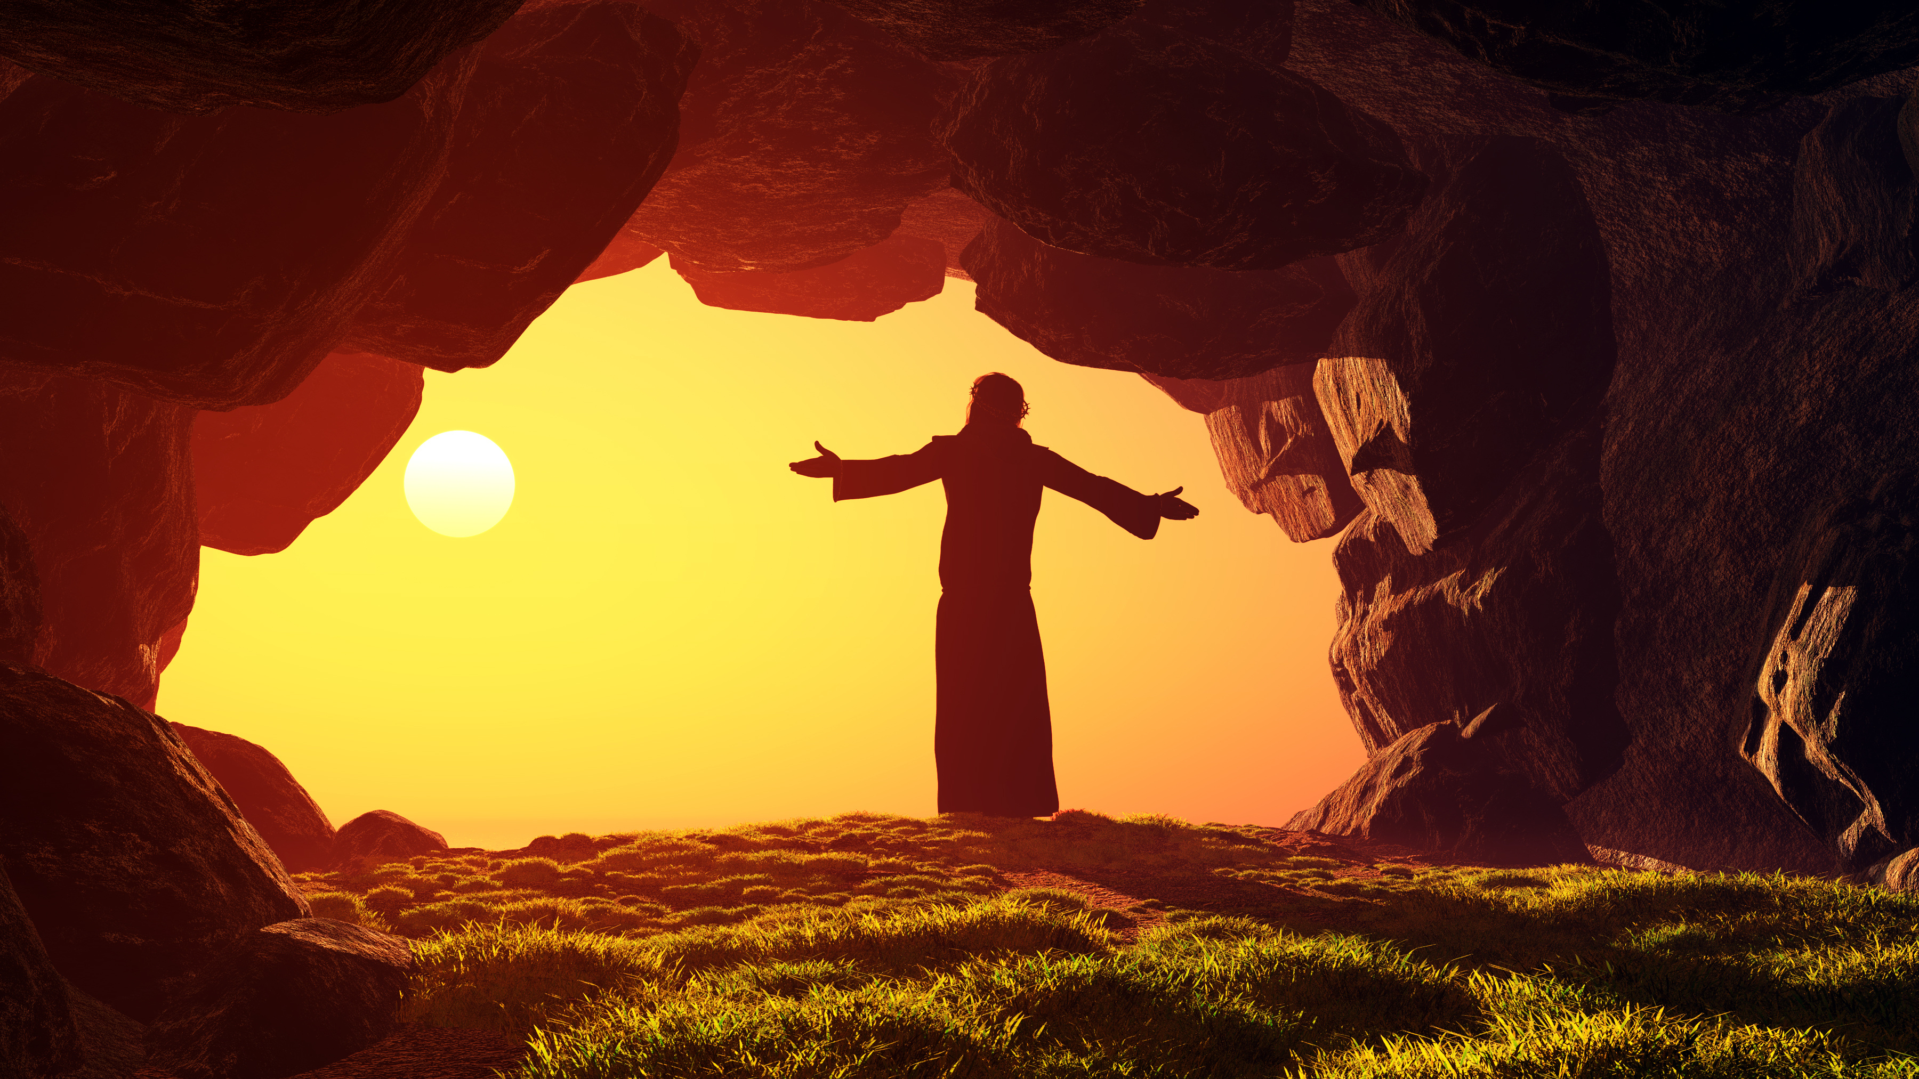
II. Resurrection Guaranteed (part 2)
Dr. Crystal Williams
Presenter

Slide 34
What is Hope?
The feeling that what is wanted can be had or that events will turn out for the best.

Slide 35
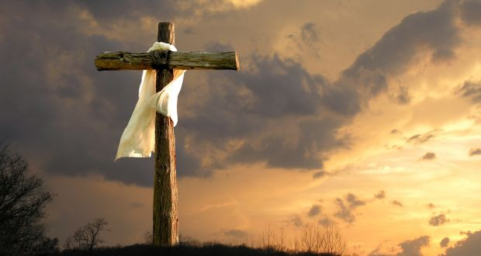
Have you ever tried to instill hope in someone?
How?
Truth
Cause and Effect
Beneficial Outcome

Slide 36
Paul presents them with the truth
1 Corinthians 15:20
But now is Christ risen from the dead, and become the firstfruits of them that slept.

Slide 37
Paul shows Cause and Effect
²¹ For since by man came death, by man came also the resurrection of the dead.
²² For as in Adam all die, even so in Christ shall all be made alive.

Slide 38
Contrast of the 1st Adam and the last Adam Cause and Effect
Adam
Christ
Brought Death
All die
Was made a living soul
Of the earth
Because of his disobedience sin entered the world
Brought Life
All are made alive
Was a quickening Spirit
The Lord from Heaven
Because of His obedience many were made righteous

Slide 39
Paul begins to tell them the BENEFITS
²³ But every man in his own order: Christ the firstfruits; afterward they that are Christ's at his coming.

Slide 40
How does the resurrection of Jesus provide hope for the believer?

Slide 41
III. The Resurrection of Hope
Elder Charles Ammons
Presenter

Slide 42
I Corinthians 15
⁴² So also is the resurrection of the dead. It is sown in corruption; it is raised in incorruption:
⁴³ It is sown in dishonour; it is raised in glory: it is sown in weakness; it is raised in power:
⁴⁴ It is sown a natural body; it is raised a spiritual body. There is a natural body, and there is a spiritual body.
⁴⁵ And so it is written, The first man Adam was made a living soul; the last Adam was made a quickening spirit.

