Slide 1
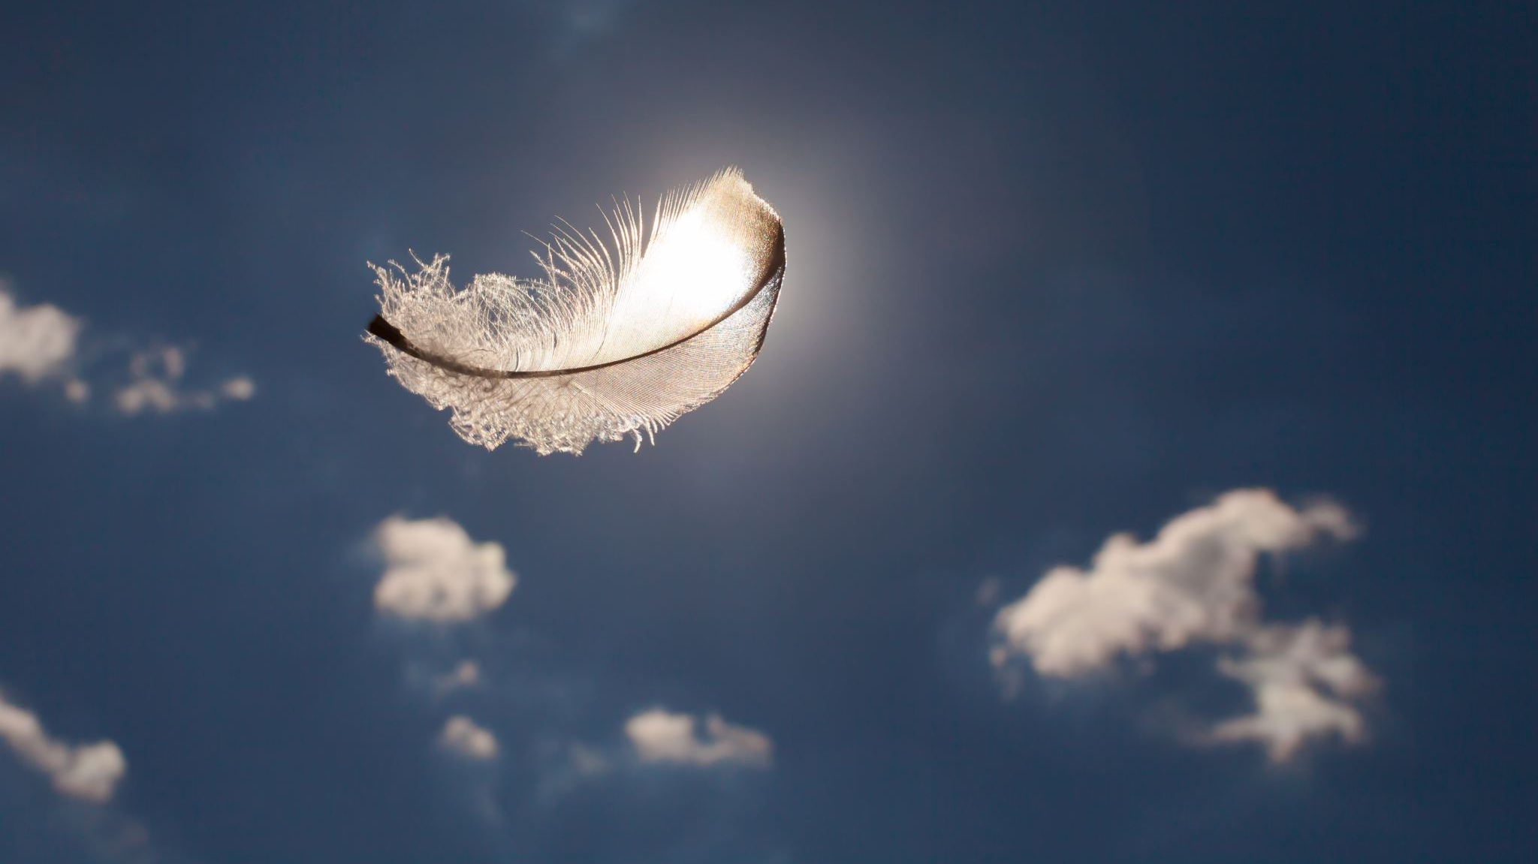
AN OATH OF INNOCENCE
Lesson 11
COGIC World Mission Topics
Presented By Elder B. Verner (05/12/2020)

Slide 2
AN OATH OF INNOCENCE
Lesson Text: Job 31:1-37
Memory Verse: Job 31:35
35 Oh that one would hear me! behold, my desire is, that the Almighty would answer me, and that mine adversary had written a book. KJV

Slide 3
AN OATH OF INNOCENCE
Key Terms
Indictment – A formal accusation of crime.
Oath – A solemn pronouncement to affirm the truth of a statement or to pledge a person to some course of action.
Presumptuous – Going beyond what is right or proper; venturing without authority or permission.

Slide 4
AN OATH OF INNOCENCE
Suggested Emphasis
Legal Processes of ancient Israel contained “oath of innocence” in which the accused would proclaim or declare their innocence before God. This oath was accepted as settling a case where there was no clear evidence of guilt. This oath put God himself as the judge and it was believed that he would rain down curses on the individual if they were not telling the truth.

Slide 5
AN OATH OF INNOCENCE
Because of the grave consequences taking this oath was considered a solemn religious act.
Job 31 is the oath of innocence proclaimed by Job before his friends Eliphaz, Bildad and Zophar.

Slide 6
AN OATH OF INNOCENCE
Emphasis 1: A Recitation of His Righteous Acts
Job started by rehearsing his manner of life. Job plumbed his conscience in relation to any temptations he faced.
Job stated: “I made a covenant with mine eyes: why then should I think upon a maid?” This statement relates to the natural proclivity of men to gaze upon and lust after women.
Job is stating that he has not engaged in “ reckless eyeballing” Job took great care to avoid lustful behavior.

Slide 7
AN OATH OF INNOCENCE
Job also stated: “If I walked with vanity, or if my foot hath hasted to deceit; Let me be weighed in an even balance, that God may know mine integrity”
Job was declaring that his public interactions were without vanity or deceit.
Job was saying in other words: “If I’ve been dishonest in my dealings with men, may God give me my just deserts.”

Slide 8
AN OATH OF INNOCENCE
Job went on to proclaim that he did not pervert justice to acquire someone else’s property.
1
Job also declared that he did not seduce someone else’s wife. He declared that if he had then let his wife be seduced by others.
2
Job declared that he had been fair to his servants, generous to the poor, fed the hungry and clothed the naked.
3

Slide 9
AN OATH OF INNOCENCE
Job declared that he had never harmed an orphan(v.21)
Never lusted for wealth(v.24)
Never been lifted up in pride (v.27)
Never returned evil for evil (v. 29)
He had always been hospitable to strangers (v. 32)
He had been candid about his faults (v. 33)
He had been bold to engage with the world (v. 34)

Slide 10
AN OATH OF INNOCENCE
Emphasis 2: One Last Mockery of the Prosecution’s Case
Job had made a proclamation of his oath of innocence and now he wanted to give out a final barrage on his prosecutors before he rested his defense. He stated “that mine adversary had written a book … surely I would take it upon my shoulder, and bind it as a crown to me” (Job 31:35-36) Job mocked even the idea that there could be a valid indictment against him.

Slide 11
AN OATH OF INNOCENCE
Job was convinced that there were no serious matters against him. Whatever he was being accused of he could bear as an insignificant weight. He asserted if there were any charges against him they would be insignificant matters. He felt that he could meet his prosecutor as an equal and give him an accurate accounting of all his actions.

Slide 12
AN OATH OF INNOCENCE
Emphasis 3: The Taint of Self-Righteousness
Job presented all of this as his final comeback against his friends that had accused him of sin.
He also considered this as his closing argument against God.
Since his friends had no clear cut evidence against him his oath would win out.
However, Job did not win against God.

Slide 13
AN OATH OF INNOCENCE
The court image of plea and argument is pointless when you consider man and his maker. Job may have been able to stand against his friends in this matter but he could never stand against God.
Jobs unblemished record gave him no leverage against God.
Job could have no expectations about what treatment he deserved.
God is sovereign and he judges on grounds that we only attempt to understand.

Slide 14
AN OATH OF INNOCENCE
Job ultimately had succumbed to the frailty of human logic.
He presumed that he had the moral high ground over God.
As many do today, he allowed his moral integrity to become a barrier between himself and almighty God.
Job became self-righteous.

Slide 15
AN OATH OF INNOCENCE
Mission Application Questions:
What was an oath of innocence? Why did it play an important role in the ancient legal system?
2. Why was Job’s long recitation of virtues evidence that he was self-righteous?
3. Do our righteous acts give us leverage with God? Why or why not?

Slide 16
AN OATH OF INNOCENCE
World Mission Prayer Points
Let us pray to remember the privilege it is to be in the presence of the Almighty.
Let us pray to be humble while boldly coming to the throne of grace.
Let us pray to understand all of our righteousness is as filthy rags in God’s presence.

Slide 17
AN OATH OF INNOCENCE
Isa 64:6
6 But we are all as an unclean thing, and all our righteousnesses are as filthy rags; and we all do fade as a leaf; and our iniquities, like the wind, have taken us away.
KJV

Slide 18
AN OATH OF INNOCENCE
Eph 2:7-10
7 That in the ages to come he might shew the exceeding riches of his grace in his kindness toward us through Christ Jesus.
8 For by grace are ye saved through faith; and that not of yourselves: it is the gift of God:
9 Not of works, lest any man should boast.
10 For we are his workmanship, created in Christ Jesus unto good works, which God hath before ordained that we should walk in them.
KJV

Slide 19
AN OATH OF INNOCENCE
Eph 3:20
20 Now unto him that is able to do exceeding abundantly above all that we ask or think, according to the power that worketh in us,
KJV

Slide 20
AN OATH OF INNOCENCE
Jude 24-25
24 Now unto him that is able to keep you from falling, and to present you faultless before the presence of his glory with exceeding joy,
25 To the only wise God our Saviour, be glory and majesty, dominion and power, both now and ever. Amen.
KJV

